Slide 1




Fake product identification using Blockchain
Rishav Bhattacharya 19070124055
Shahuraj Mohite 19070124040
Ankita Udgata 19070124007
Tejaswini Singanamala 19070124065

Slide 2
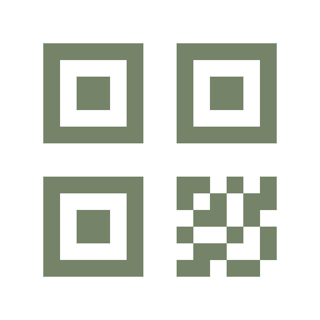
Introduction
As we all know nowadays every brand has a fake copy of them out there. Every popular brand has fake manufacturers selling the same item at cheaper rates by compromising with the actual quality. Even the experts of the original company may not be able to distinguish between fake products and their real products. What if we use blockchain technology to detect original products and add a QR code to them while manufacturing. The QR code of the product will be linked to a Blockchain. We can store the product details and generated QR code of that product as blocks in the database. Now people would be able to scan the QR code using their smartphones and their smartphones will tell them whether the product is fake or not. It will compare the scanned QR code against entries in the Blockchain database. If the code matches, it will give a notification to the customer that the product is original, otherwise it will give the notification that the product is fake.

